Slide 1



Application of Knowledge Graphs in Life Sciences Diseases, Drugs & Pathogens, Drug Discovery — January 2023
IBM Confidential

Slide 2



Agenda
Use case overview
Why Knowledge Graph & What questions can the KG answer
Data Set Structure & Source
Architecture
Demo (Basics, Visualization + Data science)
Questions
IBM Confidential

Slide 3
Disease, Pathogen & Drugs - Use Case Overview
Representative Relationships
Disease A
Disease B
Problem Description:
Diseases, Pathogens and Drugs have relationships that cross in multiple ways. The relationship can be thought about as a very complex network. This complex network is extremely hard to be represented in traditional data base structure. As a result extracting intelligence is very hard in the traditional db structure.
Typical Questions that are :
What are the pathogens causing certain kind of diseases?
What drugs are effective in handling a certain class of pathogens?
Are there commonalities between certain drugs?
Are there commonalities between certain kinds of diseases
Disease C
Drug XYZ
Pneunomia
Trichinosis
Tuberculosis
Pulmonary
Disease
Prednisolone Sodium Phosphate (PSA)
Solution:
By leveraging graph structure our solution has built Enterprise Knowledge Layer which will serve a Single Source of Truth for the Disease,Drug and Pathogen network that is easily queried, flexible and agile
The solution comprises of basic analytics / EDA that provides intelligent insights on the overall graph structure
Advanced Analytics with Data science - By means of Graph Algorithms and Machine Learning (Supervised & Unsupervised) our solutions delivers diseases analytics such as Clustering , PageRank to discover groups of diseases which can be cured by similar groups of medicines or having similar traits
Solution Architecture - Ingestion occurs from several sources(xml,json,xls) and micro-services(ML/ETL). Includes an User Interactive Dashboard with NeoDash for mining basic analytics and EDA . Integrated with datascience layer for advanced analytics insights
Idiopathic Pulmonary
Disease
Aspergillosis
Mycobacterium
Tuberculosis
Drug
Legend
Disease
Pathogen

Slide 4
Use Case Overview
Data Source:
Based on our observations we concluded that there are many treasures in the Kyoto Encyclopedia of Genes and Genomes (KEGG) database. One of them is without doubt the KEGG Disease Database. This database contains details about many known human diseases. Moreover, together with other databases such as Genome, Drug and Genes, KEGG provides us with a very extensive network of knowledge about disorders, their causes and drugs. A graph database like Neo4j is instrumental to knowledge discovery in biomedical research. This trove of information from KEGG is perfect for such a data project.
Important Links :
https://www.genome.jp/kegg/disease/
https://www.genome.jp/brite/br08401
User Personna:
This POC can prove to be a very useful tool for the Epidemiologists, Drug discovery researchers and Drug synthesis industry.
Identify multipurpose drugs and in a way using these information to drive the decision making pipelines pertaining to drug synthesis and discovery chain.
Form disease communities with Louvain and discover the most connected diseases with PageRank to identify patterns related to symptoms and discover commonalilties related to common compounds/anti-dote usage.

Slide 5
Use Case Overview
Data Source:
Based on our observations we concluded that there are many treasures in the Kyoto Encyclopedia of Genes and Genomes (KEGG) database. One of them is without doubt the KEGG Disease Database. This database contains details about many known human diseases. Moreover, together with other databases such as Genome, Drug and Genes, KEGG provides us with a very extensive network of knowledge about disorders, their causes and drugs. A graph database like Neo4j is instrumental to knowledge discovery in biomedical research. This trove of information from KEGG is perfect for such a data project.
Important Links :
https://www.genome.jp/kegg/disease/
https://www.genome.jp/brite/br08401
User Personna:
This POC can prove to be a very useful tool for the Epidemiologists, Drug discovery researchers and Drug synthesis industry.
Identify multipurpose drugs and in a way using these information to drive the decision making pipelines pertaining to drug synthesis and discovery chain.
Form disease communities with Louvain and discover the most connected diseases with PageRank to identify patterns related to symptoms and discover commonalilties related to common compounds/anti-dote usage.

Slide 6
What Are the Advantages of Using a Graph Database?
What Are the Advantages of Using a Graph Database?
Performance:
For intensive data relationship handling, graph databases improve performance by several orders of magnitude. With traditional databases, relationship queries will come to a grinding halt as the number and depth of relationships increase. In contrast, graph database performance stays constant even as your data grows year over year.
Flexibility:
With graph databases, IT and data architect teams move at the speed of business because the structure and schema of a graph model flexes as applications and industries change. Rather than exhaustively modeling a domain ahead of time, data teams can add to the existing graph structure without endangering current functionality.
Agility:
Developing with graph databases aligns perfectly with today’s agile, test-driven development practices, allowing your graph database to evolve in step with the rest of the application and any changing business requirements. Modern graph databases are equipped for frictionless development and graceful systems maintenance.
Why Graph Database are Ideal for Drug Synthesis & Epidemic Analysis Use Case ?
A major effort in translational medicine is to understand the molecular basis of disease. Analysis of high-throughput experimental data together with patient phenotypic information has led to the identification of sets of candidate genes, proteins and pathways that may be implicated in many disease conditions.
However, in order to build a higher level picture of the underlying processes involved in the disease pathology, it is necessary to integrate various classes of heterogeneous information, and to explore the complex relationships between entities such as diseases, candidate genes, proteins, interactions and pathways.
Generally, the relationships will describe complex networks. Some genes or proteins, for example, may be associated with multiple diseases, while others may be implicated in only one or two conditions.
Additionally, some candidate genes may encode large families of sequence-similar proteins, and may thus be involved in multiple protein-protein interactions. Identification of these wider relationships between entities can help in providing biological context and in hypothesis generation on disease mechanisms.
Traversing paths through the generated network can suggest hitherto unexpected relationships between entities, (e.g. relationships between disease conditions).
So in order to represent heterogeneous entities with high variance in structure/properties(dimension)/relations it is best to choose graph as the basic data structure for the best representation and optimum search/storage performance.

Slide 7
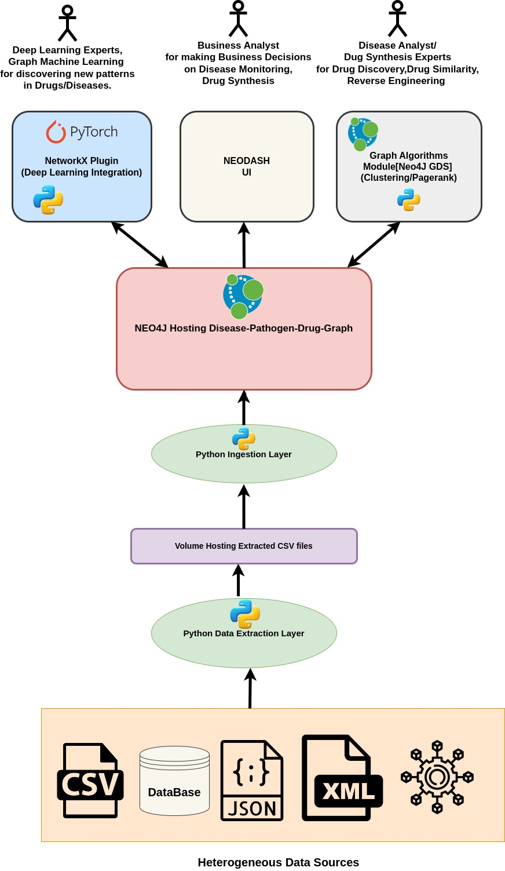
Architecture of the Disease Analytics Using Neo4J Graph Database

Slide 8
Demo
Basics (Show and tell)
Visualization (Show and tell)
Data science (Show and tell)
Other possibilities on how DS can help (Just list ideas, only tell)

Slide 9
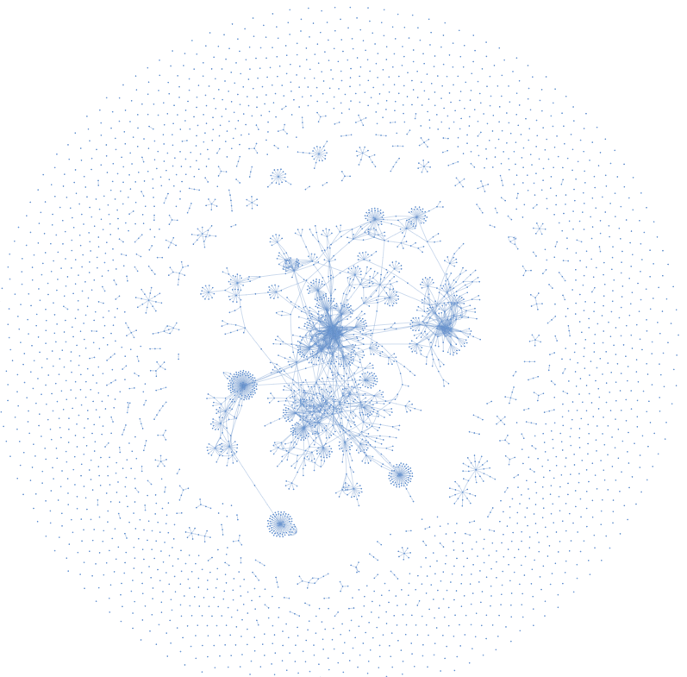
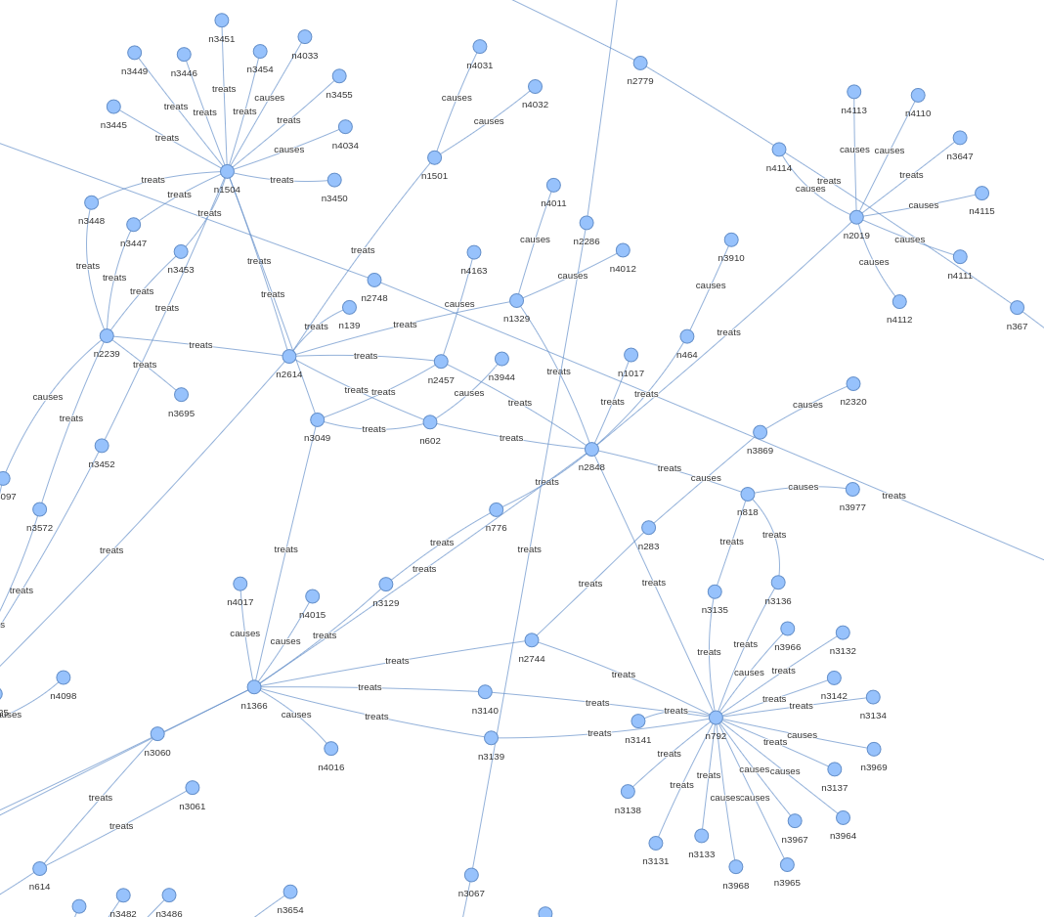
Disease Drug Knowledge Base as Neo4J Graph Constructed From Heterogeneous Data(To be Filled Up)

Slide 10
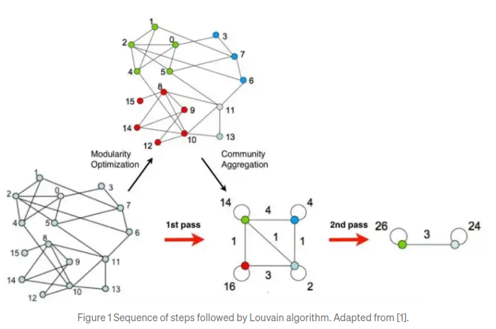
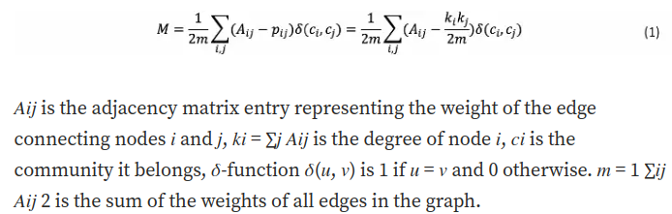
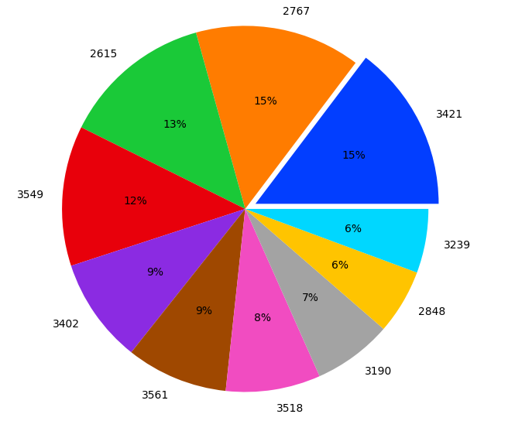
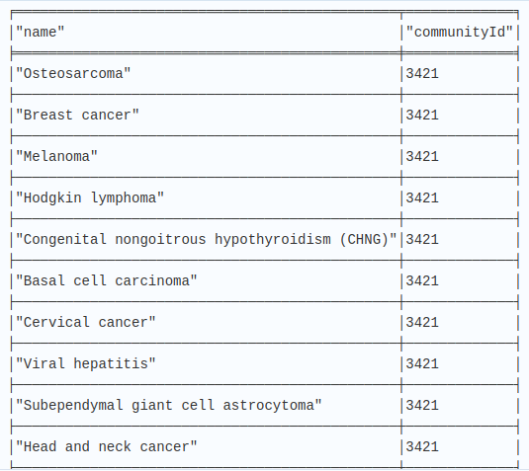
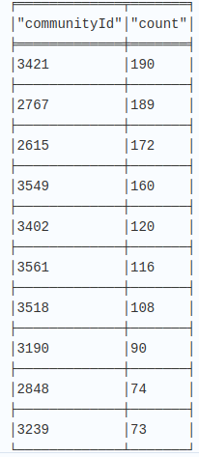
Data Science Insight # 1
Discovering Communities within Diseases Using Louvain Algorithm
Louvain Algorithm:
Louvain is an unsupervised algorithm (does not require the input of the number of communities nor their sizes before execution) divided in 2 phases: Modularity Optimization and Community Aggregation
Insight
Various communities of Diseases

Slide 11
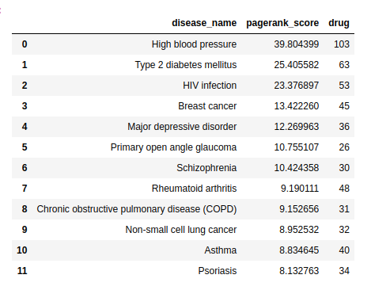
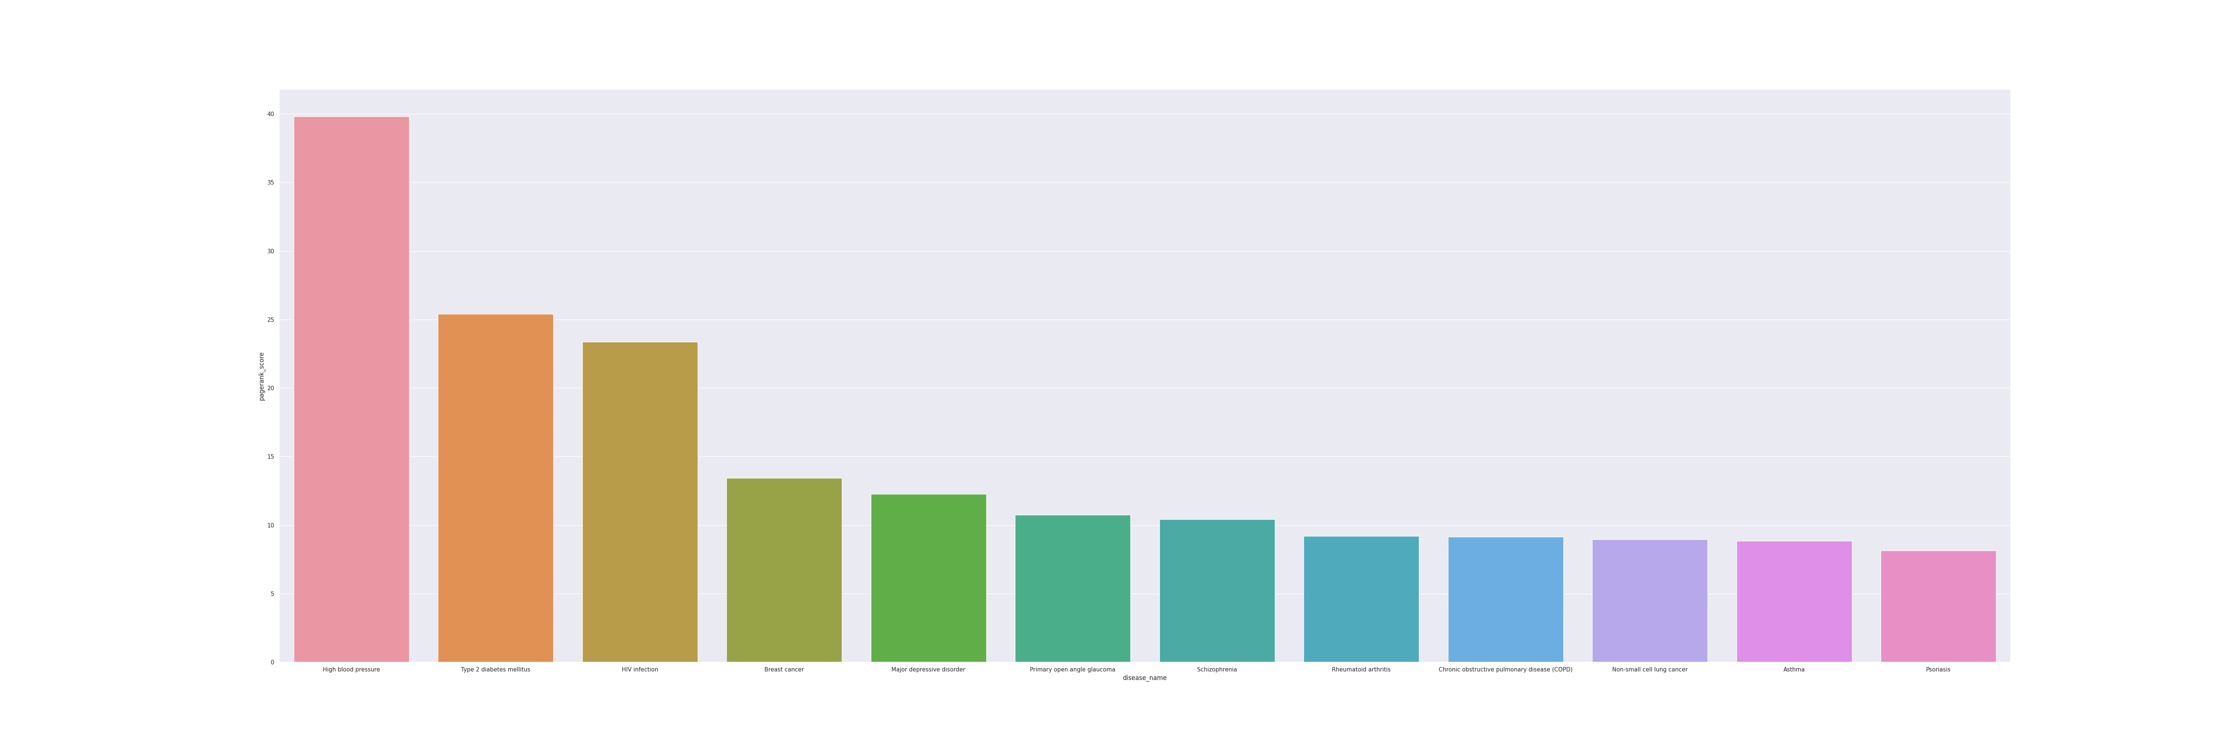
Data Science Insight # 2
Applying Page Rank Algorithm to Diseases
PageRank Algorithm:
PageRank is a link analysis algorithm and it assigns a numerical weighting to each element of a hyperlinked set of documents, such as the World Wide Web, with the purpose of "measuring" its relative importance within the set.
The algorithm may be applied to any collection of entities with reciprocal quotations and references.
The numerical weight that it assigns to any given element E is referred to as the PageRank of E and denoted by {\displaystyle PR(E).}PR(E).
Insight

